Slide 1

ISOLATED SIGN LANGUAGE RECOGNITION
SWAROOP MEHER

Slide 2
WHAT’S SPECIAL
Compact model of size < 40 MB.
A model with less latency.
Ability to run on mobile devices locally.
It’s a Kaggle competition to help the Popsign app identify signs made in processed videos, which will support the development of mobile apps to help teach parents sign language so they can communicate with their Deaf children.
February 23rd 2023 – May 1st 2023
Prize money of $50,000
Rank: 396/1165

Slide 3
DATSET
Landmark data of hands, face, and pose.
94479 rows and 56 GB
Each row has a file of shape (n_frames, 543, 3)
The landmarks were extracted from raw videos with the MediaPipe holistic model.
There are NULL values as well.
path | participant_id | sequence_id | sign
train_landmark_files/26734/1000035562.parquet | 26734 | 1000035562 | blow
.. | .. | .. | ..

Slide 4
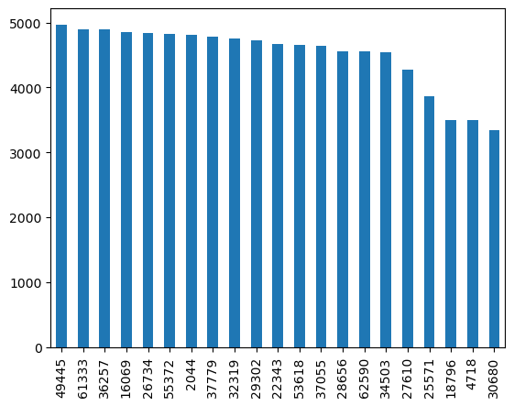

EDA
21 unique participants.
250 signs.
Each sign has around 300 – 400 rows.
The mean of no. of frames in each video is 40

Slide 5
PREPROCESSING
The most important part of this project.
Label encoding on target column.
4 various experiments
Selected
Lips, left hand, right hand, average of pose and face with 3 co-ordinates x, y, z - P1
Lips, left hand, right hand, average of pose and face with 2 co-ordinates x, y – P2
Lips, left hand, left pose with only 2 co-ordinates x, y – P3
Lips, left hand, right hand, pose, average and std. deviation of face with only 2 co-ordinates x, y, z – P4

Slide 6
MODEL
2 Dense layers with GELU actv.
(1,250)
NN
P1
0.1
(1,250)
3 Dense layers with GELU actv.
NN
0.2
dog
P2
0.7
12 headed
Transformer
P3

Slide 7
RESULTS
Preprocessing | Model | Public Test accuracy | Private Test accuracy
P1 | Fully connected NN (2Dense+GELU) | 58.7% | 63.6%
P2 | Fully connected NN (3Dense+GELU) | 57.3% | 63.7%
P3 | 12 headed Transformer | 67% | 75%
P1+P2+P3 | Ensemble of the above 3 | 69.7% | 78.4%

Slide 8
Tools and packages
Kaggle Notebooks with GPU100
Python
TensorFlow 2.0
Mediapipe
TFlite – to compress the model
NumPy
Pandas
Matplotlib

Slide 9
SUMMARY
In summary, I have successfully devised a concise and high-performing model for the purpose of categorizing American Sign Language (ASL) videos from a pool of 250 distinct signs, achieving a commendable test accuracy of 78%. Further enhancements to the model's performance can be attained through the incorporation of data augmentation techniques and the acquisition of additional data points.

Slide 10
THANK YOU
Special thanks to all my co-participants in the competition for providing valuable information.
Swaroop Meher|kaggle.com/swaroopmeher

